Slide 1
Preparing for Stage 2 has begun with product acquisition, lyophilization, filling into identical vials, labeling, packaging, and shipping. It would take an army of specialists, or 2 highly dedicated SPANners!

Slide 2
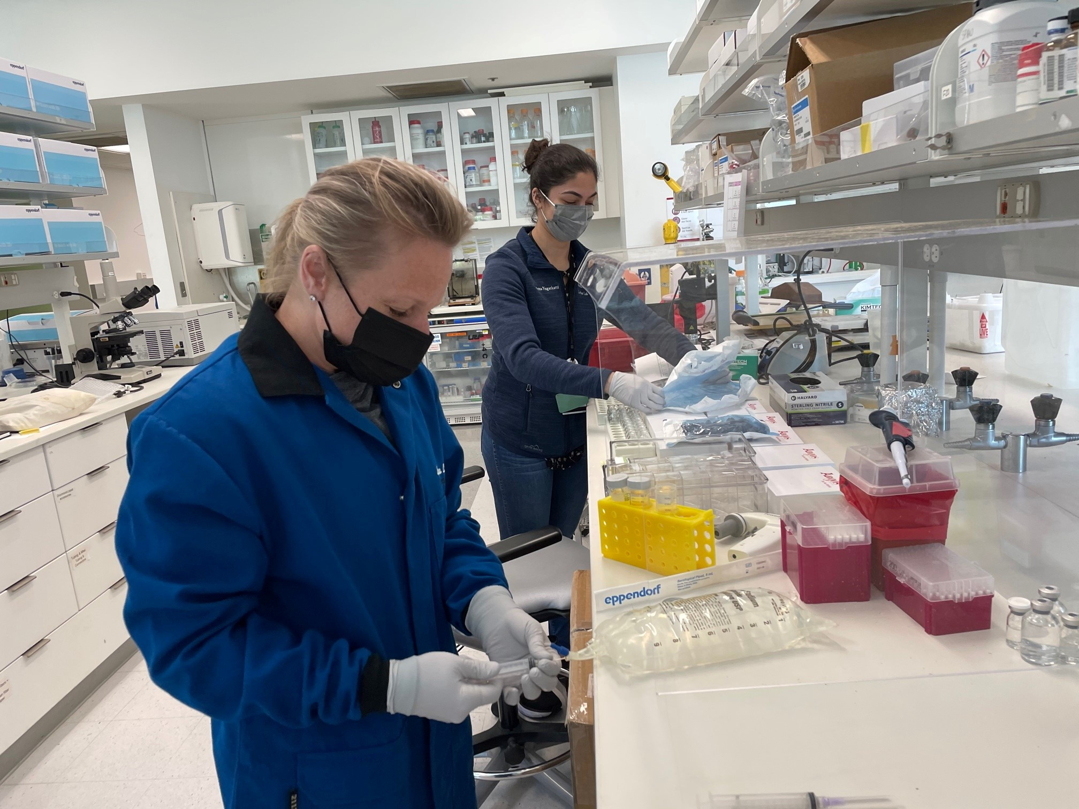
The experts

Slide 3
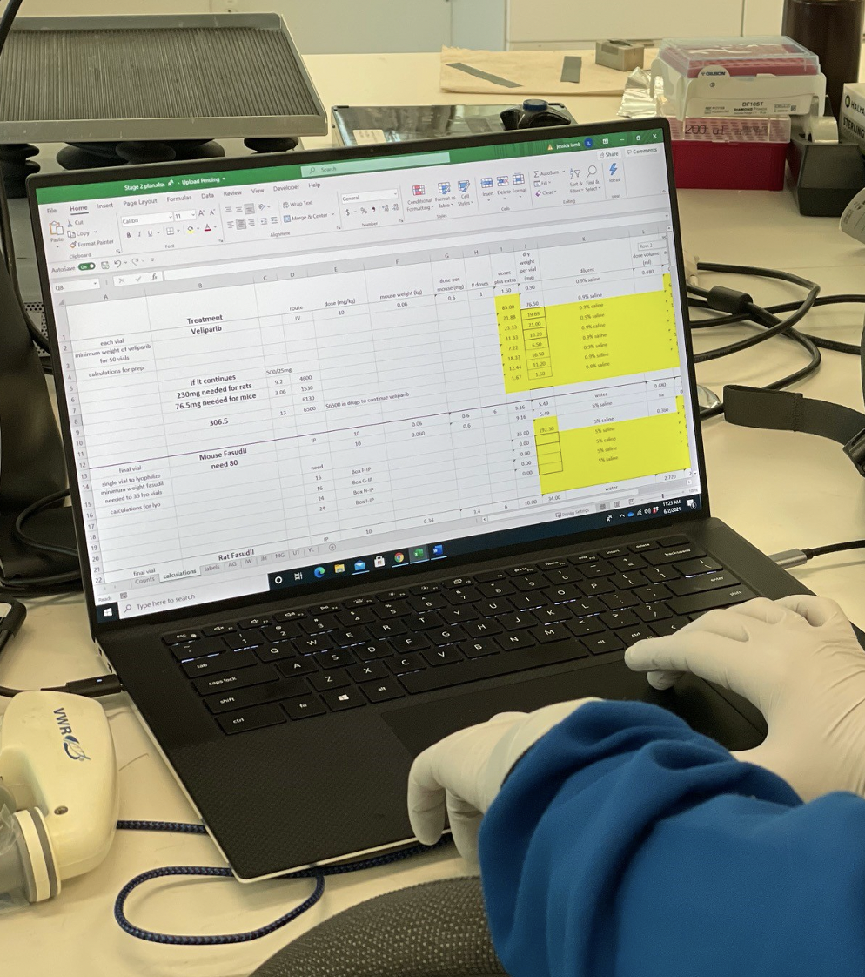
Calculating dosing

Slide 4
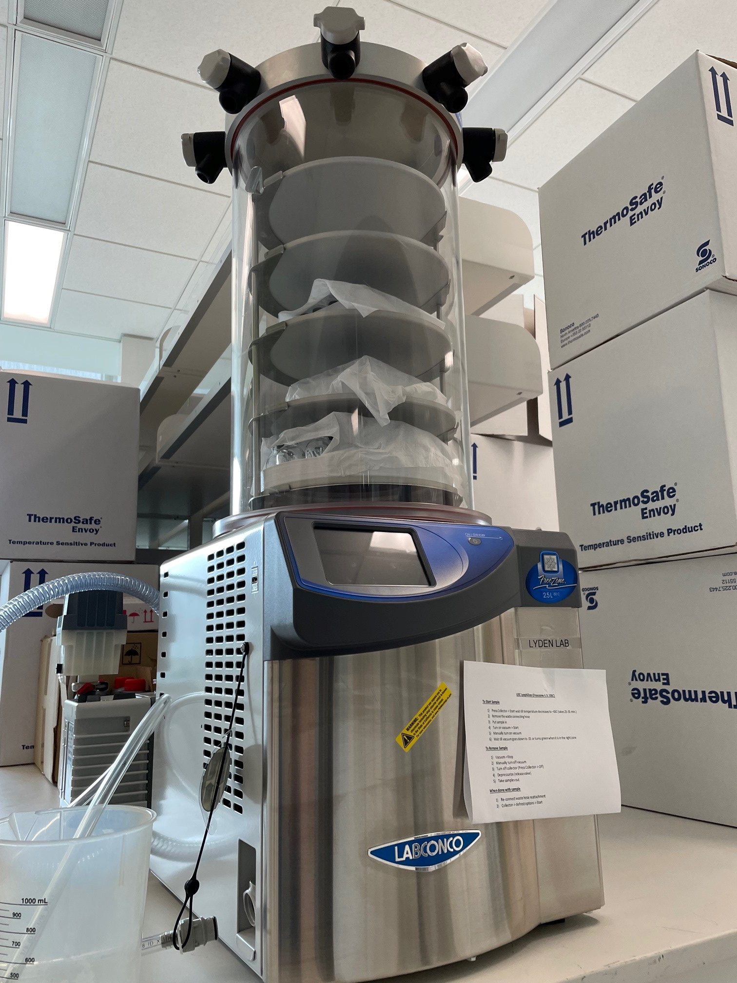
Bruce, the robo-dryer doing the lyophilization thing

Slide 5
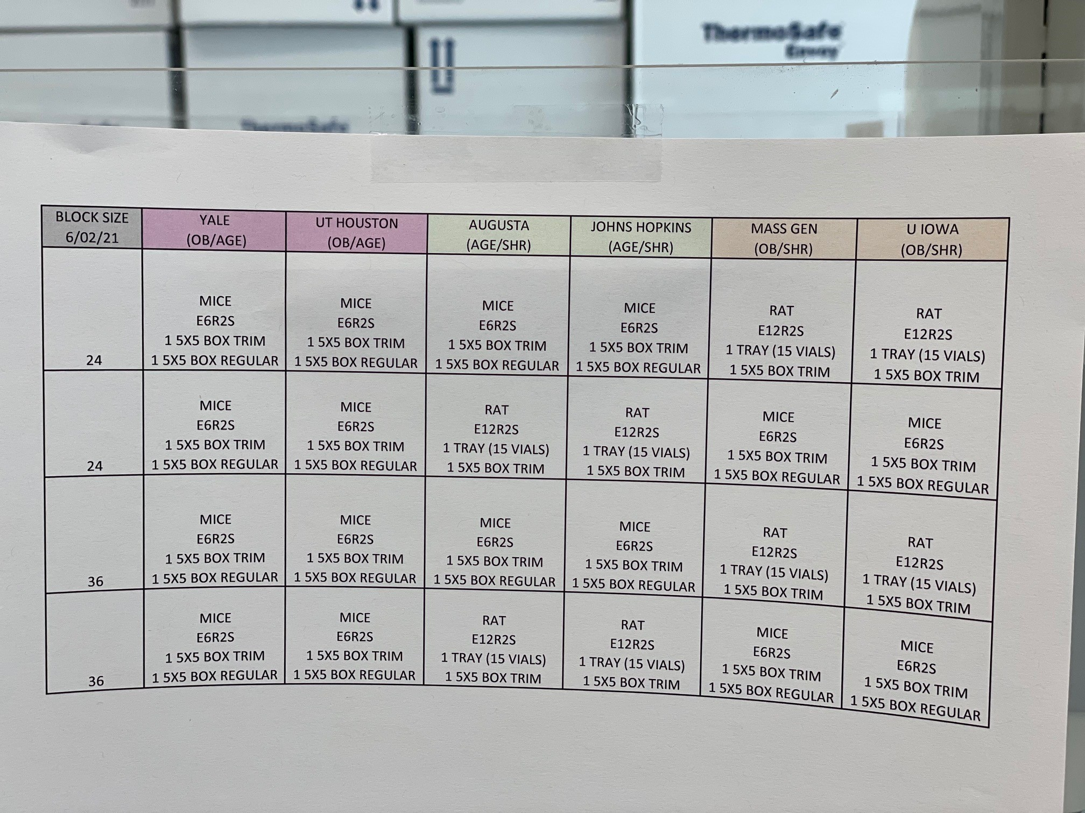
Labeling for success

Slide 6
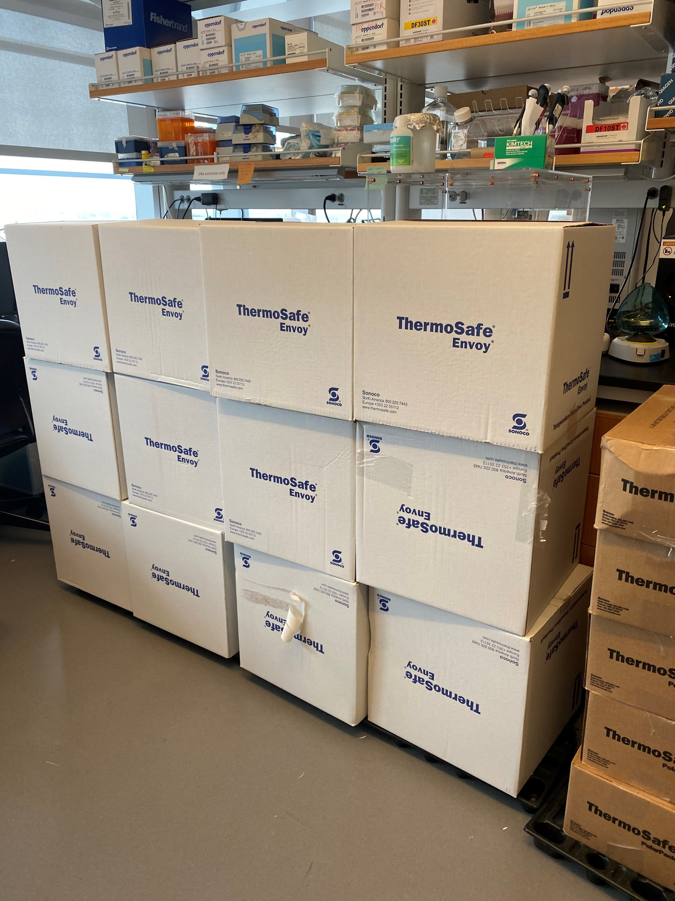
Almost ready to ship…

